Slide 1
Normalisation Dr Mariana Rocha School of Computer Science
CPMU 2007 Databases 1, Lecture 9

Slide 2

Data model
Logical model
Model in client’s mind
Databases server
Physical model
Tables on the disk

Slide 3
Data design – start at the conceptual level
Figuring out what information purposes the database is to serve:
What questions do the users need to be able to ask of the database?
What pieces of data make up this information? What type of data is it?
What things do these pieces of data describe?
How the things we want to store data about can be linked together to provide the information needed?
The result is the Logical Data Model.

Slide 4
Entity Relationship Diagram (ERD)
An Entity Relationship Diagram (ERD) shows how different entities (such as people, customers, or other objects) relate to each other in an application or a database.

Slide 5
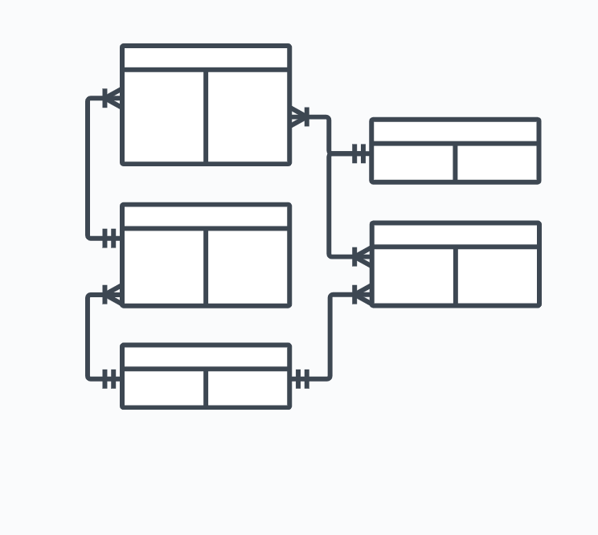
ERD components
An Entity Relationship Diagram is made up of many different components:
Entity
Attribute
Relationship

Slide 6
Entity
The entity is a thing or object of interest to the organisation being modelled. For instance, a person, a place, an object, an event, a concept
Something about which data needs to be stored to fulfil some function
Possible Entities:
Obvious physical things
Persons, places, objects
Transactions or events
Orders, Sales, Hospital Admissions, reservation
Plan, Schedule, Account, Course, Fund

Slide 7
Attribute
An entity is represented by a set of attributes, which are descriptive properties possessed by all members of an entity set.
Attribute of an entity can be:
pieces of data we want to store about an entity
a descriptive property or characteristic of an entity
We only want to record attributes that are of significance to the organisation
The value of an attribute is the value of that attribute for a particular entity occurrence (or instance)

Slide 8
Relationship
A relationship in an ERD defines how two entities are related to each other. There are several types of relationships that are represented on an ERD:
One-to-one: One record of an entity is directly related to another record of an entity
One-to-many: One record of an entity is related to one or more records of another entity.
Many to many: Many records of one entity can be related to many records of another entity.

Slide 9
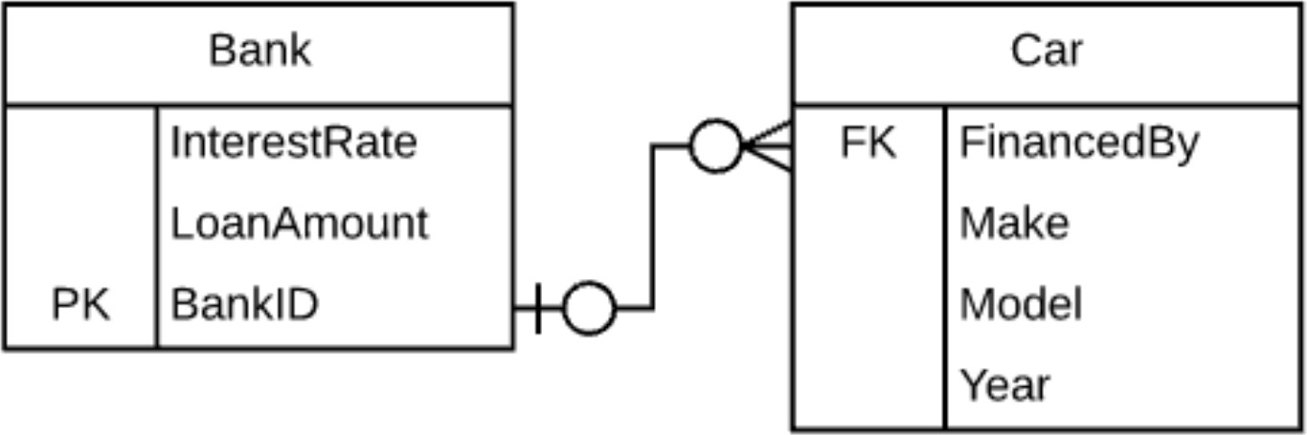
ERD

Slide 10
ERD - Structures and relationships
So what are we doing when building an ERD?
We are defining the structure of entities and the pattern of relationships between them
When we implement that structure and pattern in a physical database then we can populate it with instances of the entity

Slide 11
ERD - Structures and relationships
It is implementation independent of the DBMS
You can implement the same conceptual model in any relational database (PostgreSQL, Oracle etc.)
There may be small implementation differences, but the structure and relationships will be the same
An Entity Relationship Diagram can be drawn at three different levels:
Conceptual
Logical
Physical

Slide 12
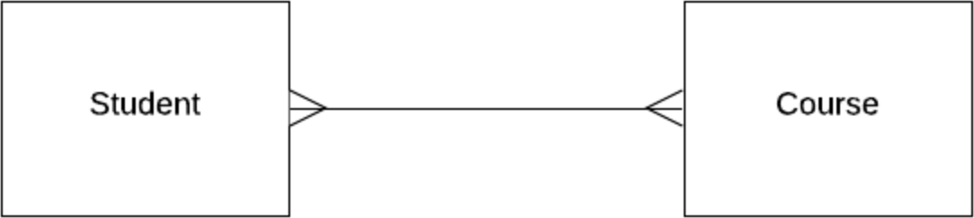
Conceptual model
A high level representation of the model showing the main entities (which may not end up as tables) mapped from design requirements

Slide 13
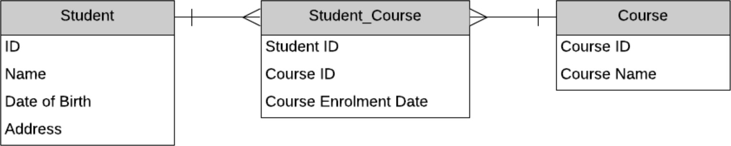
Logical model
A logical model is a more detailed version of a conceptual data model. Attributes are added to each entity, and further entities can be added that represent areas to capture data in the system.

Slide 14
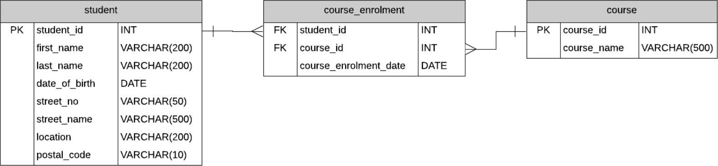
Physical model
The physical data model is the most detailed data model in this process. It defines a set of tables and columns and how they relate to each other. It includes primary and foreign keys, as well as the data types for each column.

Slide 15
Physical model
Building the model right:
Translating your logical model into the relational model
Understanding the rules
Eliminating redundancy
From which the physical database can be built

Slide 16
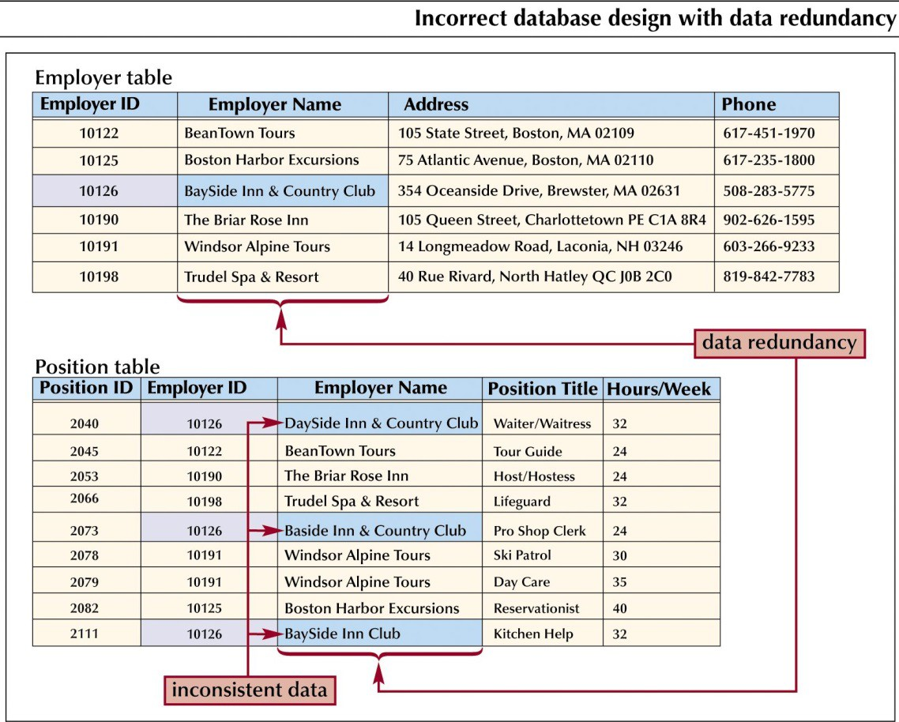
Data redundancy
Duplication of data in separate tables
Leads to waste and potential inconsistency
How to overcome this?

Slide 17
Key constraints – Foreign key
An attribute of one table that represents the relationship between this table and another
The attribute is the primary key of the other table
Foreign keys provide a method for maintaining integrity in the data (called referential integrity) and for navigating between different instances of an entity.
Every relationship between tables must be supported by a foreign key.
Foreign keys attributes are indicated by the notation (FK) beside them on database models.

Slide 18
Normalisation
A formal process involves reflecting on tables, attributes, and relationships to be created when developing a database most efficiently.
The objective of normalisation is to create relations where every dependency is on the key, the whole key, and nothing but the key.
Normalisation reduces data redundancy and increases data integrity, making it easier to save space on the server and maintain and access the data

Slide 19
Data anomalies
Normalisation came as a solution to data anomalies, like data redundancy, which takes memory space and make it hard to manage the data.
There are three types of anomalies:
Update anomalies: happen when the data is stored redundantly in the same table and someone when trying to update the data, misses some of the values.
Insertion anomalies: happen when inserting vital data into the database is not possible because other data is not there.
Deletion anomalies: happen when the deletion of unwanted information causes desired information to be deleted as well.

Slide 20
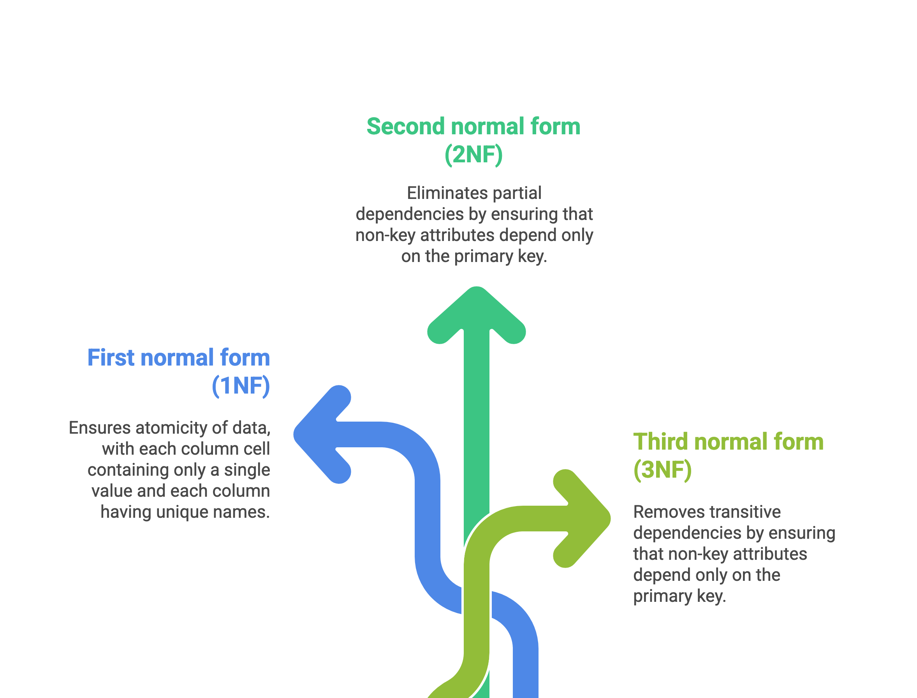
Normalisation

Slide 21
First normal form (1NF)
Each cell should contain a single value (atomic value)
All values in a column should be of the same type
Each column should be uniquely identified

Slide 22
First normal form (1NF)
In the following table, we have cells containing more than one value.
InvoiceID | CustomerName | City | ProductLine | ItemsBought | UnitPrice | Total | PaymentType | Date
INV001 | Anna Byrne | Dublin | Bakery, Fruit | 2.50, 4.00 | 6.50 | 6.50 | Credit Card | 2025-09-10
INV002 | John Murphy | Cork | Dairy | 3.00 | 3.00 | 3.00 | Cash | 2025-09-11
INV003 | Anna Byrne | Dublin | Bakery | 2.50 | 2.50 | 2.50 | Cash | 2025-09-12
How can we fix it?

Slide 23
First normal form (1NF)
InvoiceID | CustomerName | City | ProductLine | UnitPrice | Quantity | Total | PaymentType | Date
INV001 | Anna Byrne | Dublin | Bakery | 2.50 | 1 | 2.50 | Credit Card | 2025-09-10
INV001 | Anna Byrne | Dublin | Fruit | 4.00 | 1 | 4.00 | Credit Card | 2025-09-10
INV002 | John Murphy | Cork | Dairy | 3.00 | 1 | 3.00 | Cash | 2025-09-11
INV003 | Anna Byrne | Dublin | Bakery | 2.50 | 1 | 2.50 | Cash | 2025-09-12

Slide 24
Second normal form (2NF)
For a table to be in 2NF:
The database is in its first normal form (1NF)
Every attribute should be dependent on the primary key

Slide 25
Second normal form (2NF)
Here, our potential key = (InvoiceID, ProductLine).
Attributes that depend only on InvoiceID move to an Invoice table.
Invoice table
InvoiceID (PK) | CustomerName | City | PaymentType | Date
INV001 | Anna Byrne | Dublin | Credit Card | 2025-09-10
INV002 | John Murphy | Cork | Cash | 2025-09-11
INV003 | Anna Byrne | Dublin | Cash | 2025-09-12
InvoiceItems
InvoiceID (PK) | ProductLine (PK) | UnitPrice | Quantity | Total
INV001 | Bakery | 2.50 | 1 | 2.50
INV001 | Fruit | 4.00 | 1 | 4.00
INV002 | Dairy | 3.00 | 1 | 3.00
INV003 | Bakery | 2.50 | 1 | 2.50

Slide 26
Third normal form (3NF)
For a table to be in 3NF, there are two requirements:
The table should be in the second normal form.
All attributes should be determined (dependent) on the primary key and no other column. This means no attribute should be transitively dependent on the primary key. That happens when an attribute is not directly dependent on the primary key, but of another non-key attribute.

Slide 27
Transitive dependencies
We still have transitive dependencies:
InvoiceID → CustomerName → City: city depends on the customer, not directly on the invoice.
(InvoiceID, ProductLine) → ProductLine → UnitPrice: the price depends only on the product, not on the invoice.
(InvoiceID, ProductLine) → (UnitPrice, Quantity) → Total: Total is derived from other non-key attributes (price × quantity).

Slide 28
Third normal form (3NF)
CustomerID (PK) | CustomerName | City
C01 | Anna Byrne | Dublin
C02 | John Murphy | Cork
ProductLine (PK) | UnitPrice
Bakery | 2.50
Fruit | 4.00
Dairy | 3.00
InvoiceID (PK) | CustomerID (FK) | PaymentType | Date
INV001 | C01 | Credit Card | 2025-09-10
INV002 | C02 | Cash | 2025-09-11
INV003 | C01 | Cash | 2025-09-12
InvoiceID (FK) | ProductLine (FK) | Quantity
INV001 | Bakery | 1
INV001 | Fruit | 1
INV002 | Dairy | 1
INV003 | Bakery | 1

Slide 29
Normalisation
There are up to six normal forms available. It is recommended we try to normalise the database up to the 3NF.
We can keep dividing the tables more and more – however, we need to always reflect on how necessary those divisions are

Slide 30
Normalisation
Database normalisation:
makes the database more efficient.
prevents the same data from being stored in more than one place (called an “insert anomaly”)
prevents updates from being made to some data but not others (called an “update anomaly”)
prevents data not being deleted when it is supposed to be or data from being lost when it is not supposed to be (called a “delete anomaly”)
ensures the data is accurate
reduces the storage space that a database takes up
ensures the queries on a database run as fast as possible

Slide 31
What are normal forms?
The process of normalisation involves applying rules to a set of data. Each of these rules transforms the data to a certain structure, called a normal form.
There are three main normal forms that you should consider
Whenever the first rule is applied, the data is in “first normal form“. Then, the second rule is applied and the data is in “second normal form“. The third rule is then applied and the data is in “third normal form“.

Slide 32
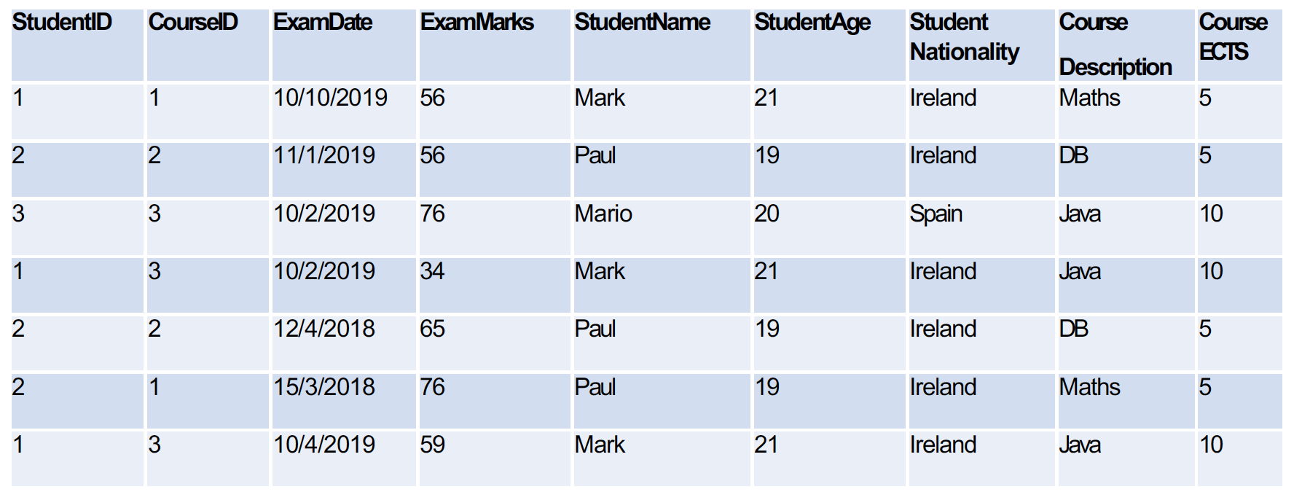
Normalisation – another example

Slide 33
1NF
If repeating groups are present, they have to be broken down into individuals’ records and a primary key has to be assigned.
In the example above, we need to find a key for the table.
The composite key StudentID + CourseID + ExamDate is unique and it will represent our primary key.
StudentID | CourseID | ExamDate | ExamMarks | StudentName | StudentAge | Student Nationality | Course Description | CourseECTS

Slide 34
2NF
A partial dependency is a dependency between a non-key field (a field that is not part of the primary key) and a field that is part of the primary key.
For instance, in our example, the student name depends on the studentID.
The studentID is enough to tell us studentName. We do not need to know the full table key (StudentID+CourseID+ExamDate).

Slide 35
2NF
In the second normal form, the starting table most likely has to be divided in smaller tables so that every field in each table depends on the full primary key of that table.
In this way the partial dependencies are removed.

Slide 36
2NF
StudentID -> StudentName, StudentAge, Student Nationality (if I know the studentID, I can know the StudentName, StudentAge and Student Nationality)
CourseID -> Course Description, Course ECTS (if I know the CourseID, I can know the Course Description and the ECTS (European credits).
StudentID, CourseID, ExamDate -> ExamMarks (if I know the studentID+CourseID+ExamDate, I can know the marks the student got for that exam that day).

Slide 37
2NF
StudentID | StudentName | StudentAge | Student Nationality
CourseID | CourseDescription | CourseECTS
StudentID | CourseID | ExamDate | ExamMarks

Slide 38
3NF
In the third normal form we need to ensure that every attribute that is not the primary key must depend on the primary key and the primary key only.
The set of the three tables in our example have no transitive dependencies and are already in the third normal form.
We can stop the normalisation process here.

Slide 39
Process of data normalisation
ELIMINATE REPEATING GROUPS
Make a separate table for each set of related attributes and give each table a primary key.
ELIMINATE REDUNDANT DATA
If an attribute/column depends on only part of a multivalued key, remove it to a separate table.
ELIMINATE COLUMNS NOT DEPENDENT ON KEY
If attributes/columns do not contribute to a description of the key, remove them to a separate table.
Everything should depend on the key the whole key and nothing but the key.

